Slide 1


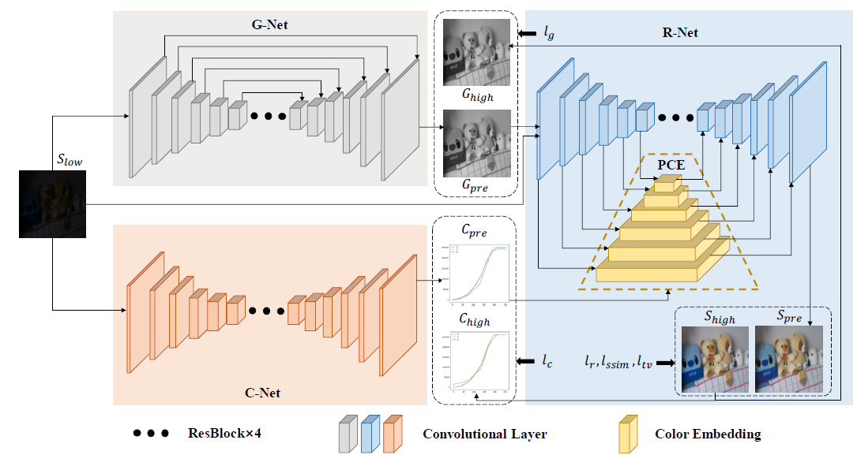
Optimize and Enhance Lowlight Image without Color Shift
Work-let expected duration – 4 months
Expectations
Optimize and advance a given AI model that can improve the brightness of the lowlight image with out effecting the color constancy of the image.
References
https://openaccess.thecvf.com/content/CVPR2022/papers/Zhang_Deep_Color_Consistent_Network_for_Low-Light_Image_Enhancement_CVPR_2022_paper.pdf
https://github.com/Ian0926/DCC-Net
Training/ Pre-requisites
Understanding in fundamentals of camera imaging and image quality metrics
Hands-on knowledge in Image processing, computer vision, machine learning, deep learning
DCC-Net: To be worked on
[ Problem Statement ]
In the real world, when a general user wants to capture images in lowlight, brightness might not be optimal due to certain limitations. While a DNN can help to increase the brightness of the network, it tends to cause color shifts compared to the original image. DCC-Net can help to improve brightness of LL image with minimal or no color shift.
Kick Off < 1st Month >
Implement the codebase publicly available.
Check the performance of network in real world scenarios.
Deliverable:
Understand the network.
Identify pros and cons such as scenarios where network is failing.
Milestone 1 < 2nd Month >
Do Ablation studies to understand importance of each component.
Identify possible components to remove or reduce.
Deliverable:
Identify points of improvement.
Modify and train.
Code delivery 1
Milestone 2< 3rd Month >
Identify networks that worked on a con of this network.
If not, choose a con to improve the network
Deliverable:
Modify and train
Code delivery 2
Milestone 3< 4th Month >
Fine tuning the model and improving results
Documentation (Learnings, Findings, Implementation, Source Code)
Deliverable:
Final Results
Code delivery 3 (Final)
Report Out
Mentors: batchu.kumar@samsung.com,
r.akella@samsung.com
janmejaya.p@samsung.com

